Slide 1
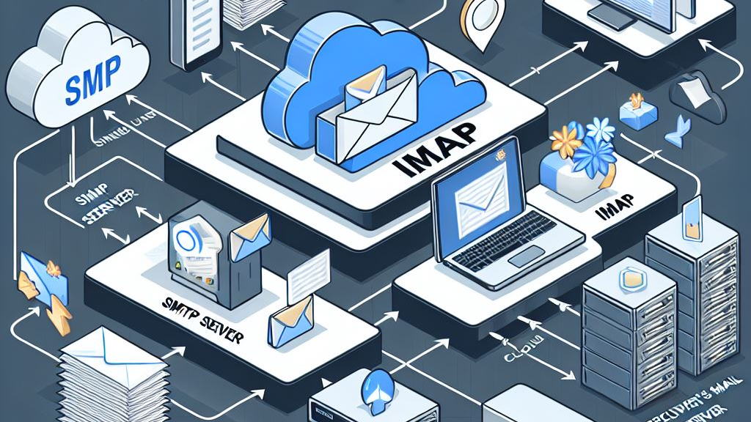
SMTP & IMAP
EMAIL PROTOCOLS
SIMHADRI.K

Slide 2
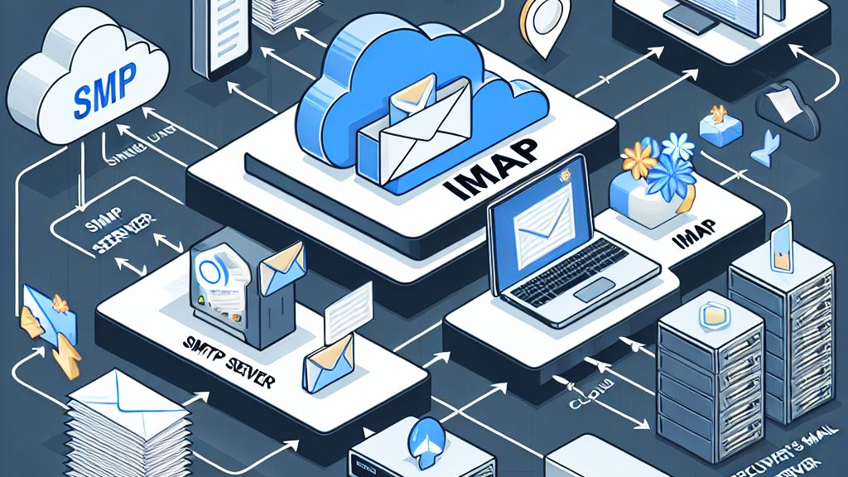
AGENDA
INTRODUCTION
SMTP & IT'S FEATURES
WORKING OF SMTP
IMAP & IT'S FEATURES
WORKING OF IMAP
ARCHITECTURE DIAGRAM
SMTP vs IMAP
ADVANTAGES & DISADVANTAGES
CONCLUSION

Slide 3
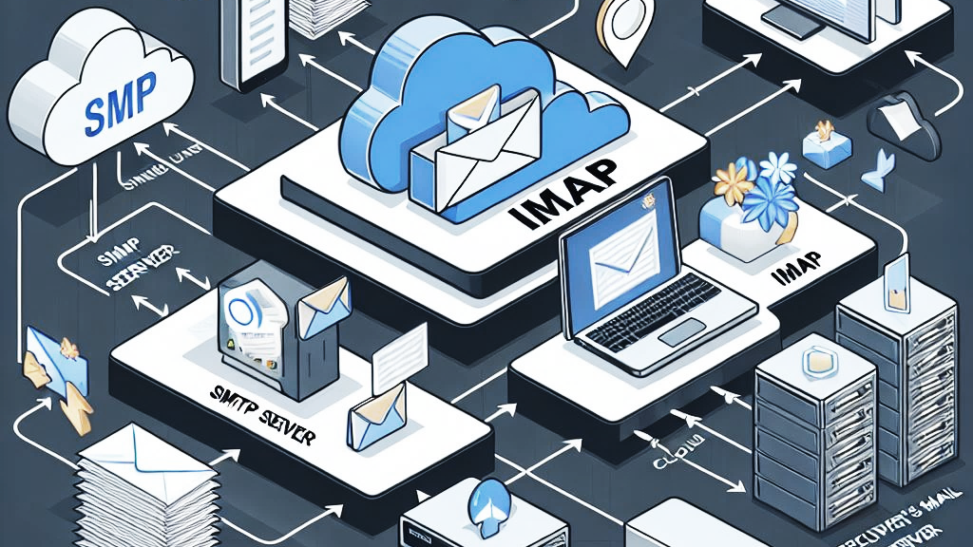
INTRODUCTION TO EMAIL COMMUNICATION
Email
Sends messages over the InTERNET
Fast, easy & free.
Used in Offices, schools & Daily life
Can send files, photos, & links.

Slide 4
SMTP
Designed by RFC 821 in 1982.
SMTP model has two types:
End-to-End method
Store-and-Forward method.
Uses port 25, 465, or 587.
Features of SMTP
Email Transmission
Client-Server Communication
Queue Management
Authentication

Slide 5
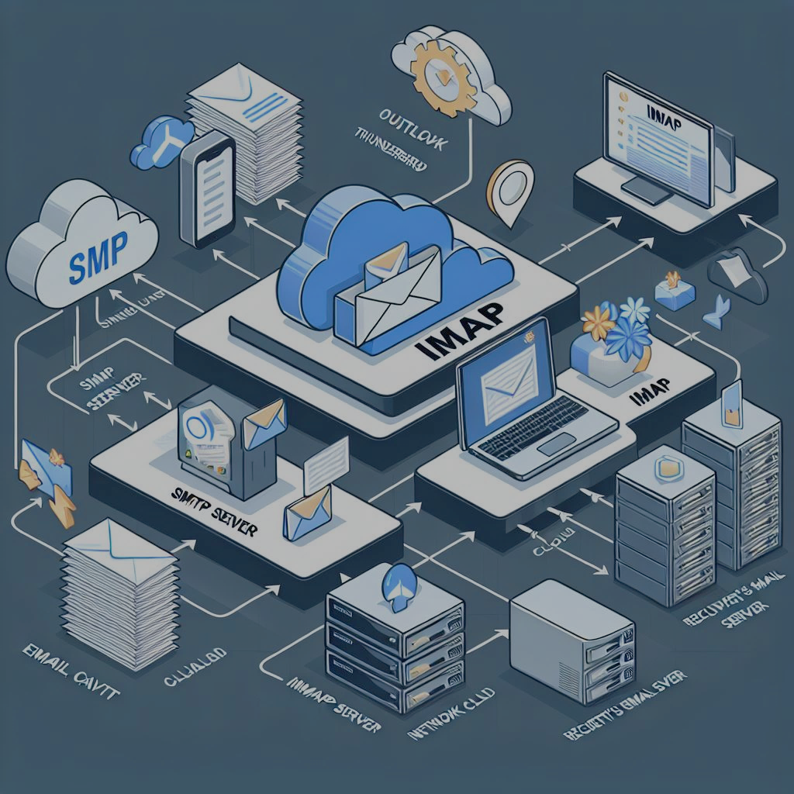
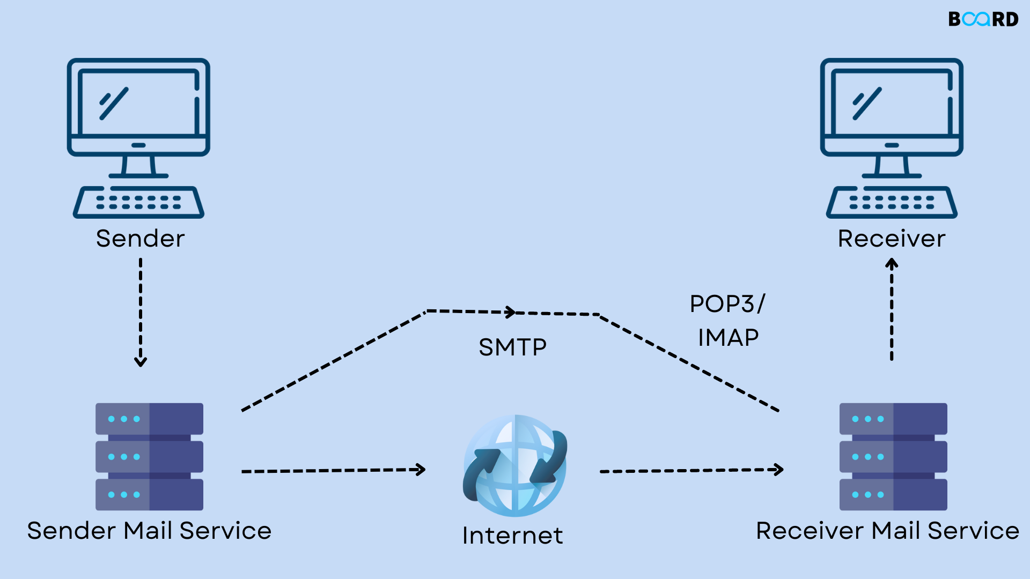
WORKING OF SMTP

Slide 6
IMAP
Designed by Mark Crispin in 1986.
Current Version of IMAP is IMAP4.
Syncs email in real time
Features of IMAP
Server-Side Storage
Synchronization
Folder Management
Multiple Access
Search Capabilities

Slide 7
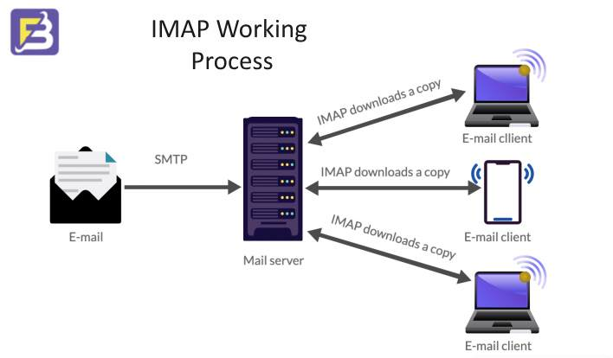

Slide 8
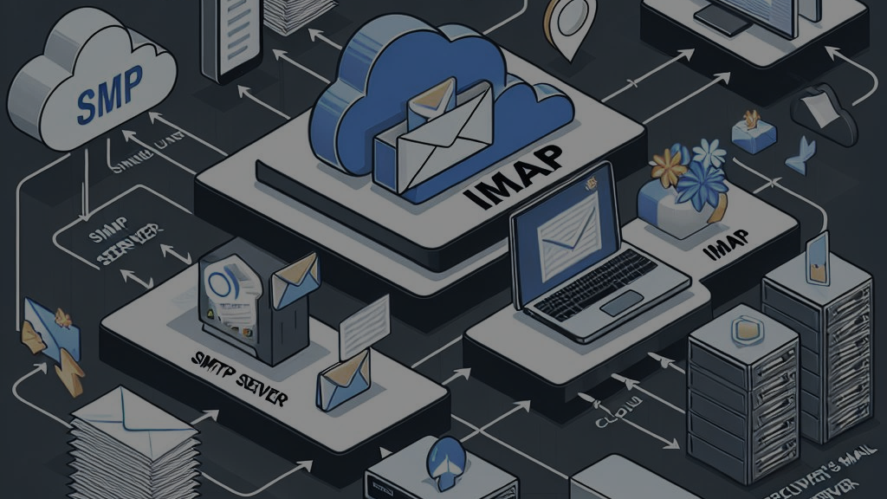
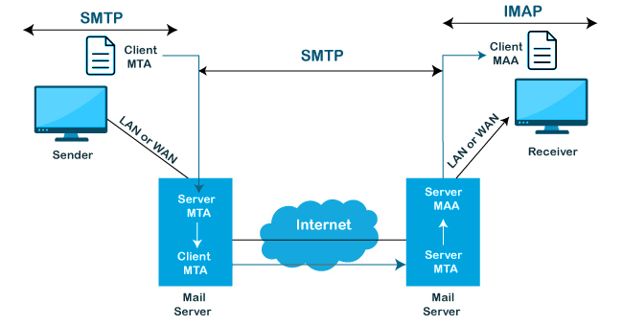
ARCHITECTURE DIAGRAM

Slide 9

SMTP Vs IMAP
Feature | SMTP | IMAP
Full Form | Simple Mail Transfer Protocol | Internet Message Access Protocol
Purpose | Sends emails | Reads emails
Storage | Doesn’t store emails | Emails stay on server
Access | One-way (send only) | Two-way (sync & read)
Devices | Not used for reading | Access from multiple devices

Slide 10
IMAP vs POP3
Feature | IMAP | POP3
Storage | Email stay on the server | Emails are downloaded & deleted from server
Access | Multi-device access | Usually single-device access
Sync | Two-way sync (server <-> client) | One-way (server -> client)
Folder Support | Yes (server-side folders) | No folder support
Offline Access | Needs internet for full sync | Emails available offline once downloaded
Use Case | Modern, multi-device users | Simple, single-device users

Slide 11
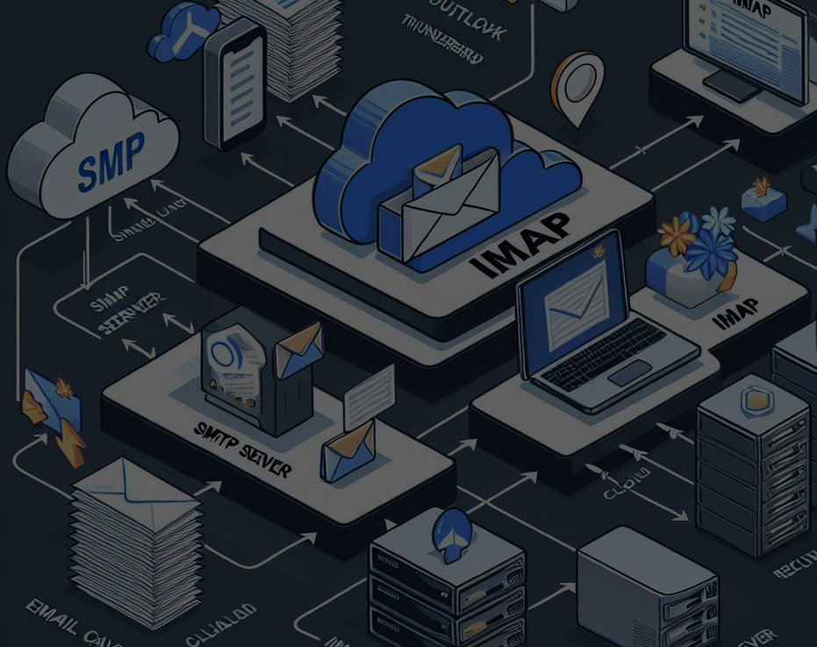
SMTP
Sending emails from clients
Server-to Server email transfer
USE CASES
IMAP
Email Backup and Archiving
Multiple device Email Access

Slide 12
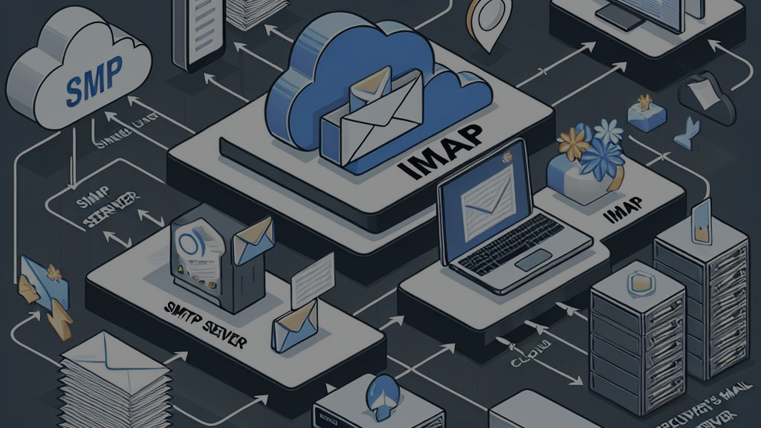
ADVANTAGES & DIS-ADVANTAGES
SMTP
IMAP
ADVANTAGES
Simple & Reliable
DIS-ADVANTAGES
Limited Authentication
Only for sending
Queueing System
Support Attachments (images, videos)
Widely Supported
Security Issues
Old Protocol
ADVANTAGES
DIS-ADVANTAGES
Uses more server storage
Needs Internet to access emails
Syncing may be slow on poor networks
Folder Synchronization
Centralized Backup
Access from multiple devices
Security depends on the server
Server- based storage

Slide 13
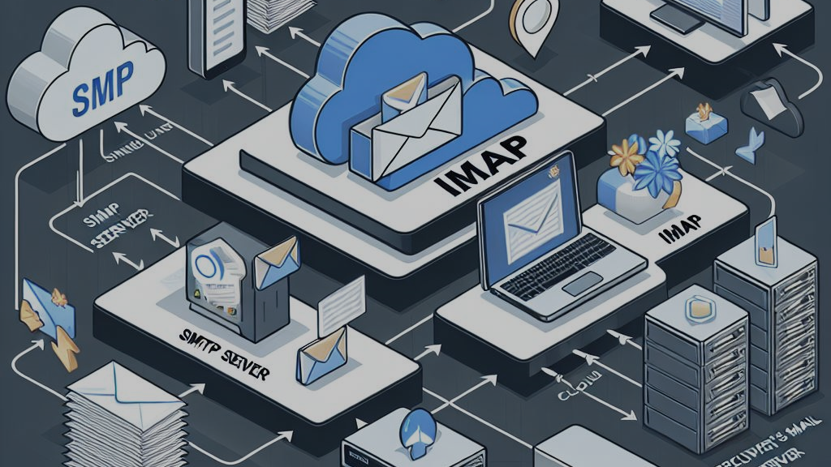
CONCLUSION

